Slide 1



Smart Irrigation System
Hardware Capstone Project
Automatic plant watering using a soil moisture sensor, relay and water pump
Notes:
Introduce the project: a smart irrigation kit that waters a plant automatically when the soil is dry.

Slide 2



Project Objective
Key Objectives
Monitor soil moisture levels in real time using electronic sensors
Primary Goal
Automate water pumping when the soil becomes dry
To design and build an automated watering system that keeps plants healthy without manual monitoring.
Conserve water by supplying only the required amount
Build a simple, low-cost, standalone circuit powered by batteries
Notes:
One primary goal and four key objectives.

Slide 3



Introduction and Overview
What is it?
The Problem
The Solution
A smart agricultural and gardening science project kit designed to automate plant care.
Traditional farming and home gardening suffer from over-watering or under-watering, leading to plant decay or dry soil.
A closed-loop automated system that senses soil conditions and triggers watering instantly, with no manual intervention.
Notes:
What the kit is, the problem it addresses and how it solves it.

Slide 4
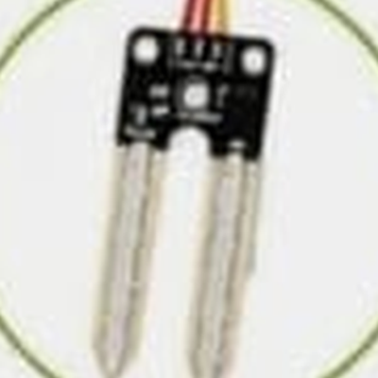
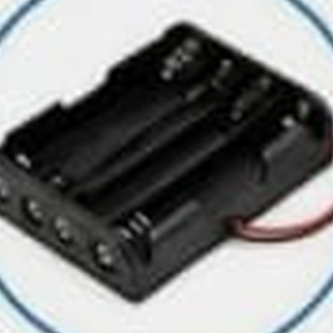
Component Breakdown: Part 1
Soil Moisture Sensor
4×AA Battery Holder
Function
Detects soil moisture level in real time.
Role
Acts as the “eyes” of the project, measuring how wet or dry the soil is.
Function
Powers the entire irrigation system.
Role
Provides a portable, safe, low-voltage (DC) power source for the circuit.
Notes:
Sensor = input. Battery holder = power.

Slide 5
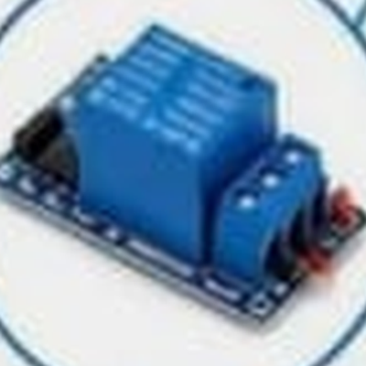
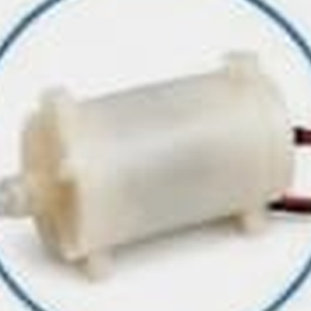
Component Breakdown: Part 2
Relay Module
5V Water Pump
Function
Automatically controls the water pump based on soil moisture signals.
Role
Acts as an electronic switch that opens or closes the circuit to turn the pump on or off safely.
Function
Pumps water from the source to the plant automatically.
Role
Delivers the physical water flow upon command from the relay module.
Notes:
Relay = controller. Pump = output.

Slide 6


Component Breakdown: Part 3
Water Pipe
Direct-Connect Architecture (No Switch)
Function
Transparent pipe used to deliver water directly from the pump to the plant pot.
Role
Channels the water path efficiently and cleanly.
The system is wired directly from the battery to the control circuitry, allowing it to remain continuously active and fully autonomous, with no manual switch needed.
Notes:
The pipe carries water. This build has no on/off switch: it stays active and autonomous.

Slide 7



Working Principle: How It Works
1
2
3
4
Step 1: Sensing
Step 2: Processing
Step 3: Switching Action
Step 4: Watering
The soil moisture sensor probes the soil in the pot to continuously check moisture levels.
If the soil is dry, the sensor sends a signal to the relay module.
The relay module triggers the 5V water pump to turn on.
Water flows through the pipe into the pot. Once the soil is wet enough, the sensor stops the pump automatically.
Notes:
Sensing, processing, switching, watering. The loop repeats automatically.

Slide 8



Applications
Home Gardening
Smart Agriculture / Greenhouses
Perfect for potted plants at home, balconies or indoor spaces when owners are away.
Small-scale automated crop management to optimize water usage.
Educational Projects
Nursery Plant Care
Excellent for school and college kits to learn electronics, automation and sensors.
Helps plant nurseries maintain uniform moisture for young saplings.
Notes:
Four places where this system is useful.

Slide 9



Advantages and Key Features
Fully Automated
Water Conservation
Operates independently based on real-time soil conditions.
Prevents water wastage by watering only when needed.
Low Voltage and Safe
Low Cost and Simple
Uses a simple 4×AA battery setup, making it safe to handle.
Easy to assemble, repair and understand as a beginner hardware project.
Notes:
Four key benefits.

Slide 10


Conclusion
Summary: The Smart Irrigation System shows how simple hardware components (sensor, relay and pump) can work together to automate daily chores.
Future Scope
Upgrade with microcontrollers like Arduino or ESP8266 for IoT-based smartphone monitoring.
Integrate solar panels for a sustainable green-energy power supply.
Notes:
Summarise, then mention future upgrades. Thank the audience.

